Slide 1



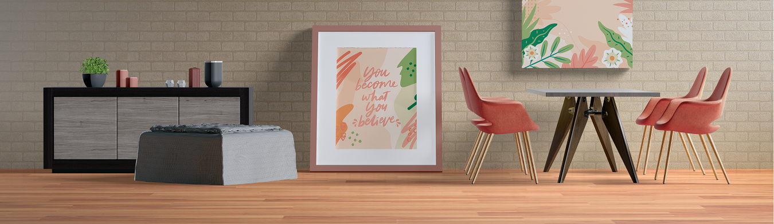
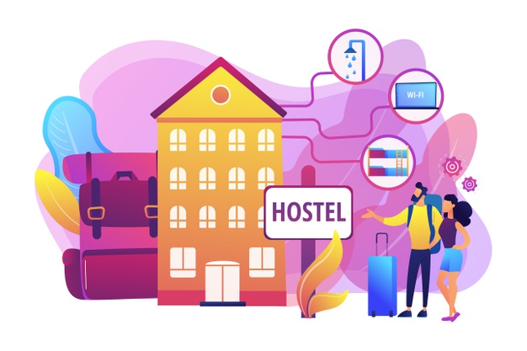




EVERY SPACE HAS A STORY
WRITE YOUR OWN
Name
Contact
Email
REQUEST CALLBACK
A SPACE THAT DELIVERS COMFORT
Beautiful life begins with the comfort and in our living spaces we aim to provide you smart living with amenities to get you comfort. We ensure that you get healthy life and peace of mind with us.
A SPACE THAT IS SECURED
Security is the most important part of any space where we live, be it physical or in any other form. We are committed to provide the highest level of secured environment protected from outsiders
COVID Protected Spaces
Multi-Layered Physical Security
LIVE THE EXPERIENCE
We have it all what you need for a Safe, Comfort & Smart Living. We aim to give to more than a traditional PG living by managing all our spaces professionally
PRE-BOOK NOW
A SPACE FOR ALL
Hostels for Boys & Girls
Suitable for Working Professionals
Separate Guest Room for Guardians for overnight stay (While you pay nothing)
WE HAVE IT ALL WHAT YOU NEED
Just bring minimal along and rest you will find all the amenities such as furnished rooms, AC, Refrigerator etc. Just look at our amenities section to see about what all we do offer.
View All Amenities
FITNESS & FOCUS IS YOURS
Good health and peace of mind is the key of great living. If you’ve subscribed our smart living, you are surely going to get our free packages of Gym & Library.
PRIME LOCATIONS
Our all properties are at the prime locations and have all the facilities, commutes etc. at walking distance. Shop anything, grab a bite or hang up with friends whenever you want.
LET US BE PART OF YOUR MEMORIES & STORIES.
Let’s Create some together
Parento Homz
Call us
Follow us
Corporate Office - A1/470 Main Market, Shakarpur, East Delhi 110092
9871775527
9953495340
9953495341
9953495343
9953495344

